Slide 1
Session 9: Managing Deployment: Teams, Critical Chain and Communication
Dr Andre Samuel

Slide 2
Session Overview
Behaviour can affect the usefulness of the critical path analysis – consider critical chain, which focuses on bottlenecks, be that the critical path or another constraint.
Recap on the role of project teams
Consider the impact of people/project team on project performance which critiques the traditional CPA
Critical Chain focuses on considering the project as a whole and focusing the constraints/bottlenecks
Critical chain involves 5 steps: Identify, Exploit, Subordinate, Elevate, Inertia.
Critical chain considers different types of constraints – the critical path, resources, etc.
Critical Chain uses project level contingency (buffer), not task level to avoid delaying the start and finish of tasks
Communication with your project team and stakeholders
Analyse the main functions and barriers to communication.
Identify techniques to give feedback to the project team
Explore how to communicate with stakeholders.

Slide 3
Project Teams

Slide 4
Project Teams
Projects are delivered by project teams
Project teams work within organisational and professional cultures and guidelines, often establishing their own local culture.
Project teams are made up of individuals who wield diverse skills, knowledge, and experience. Project teams that work collaboratively can accomplish a shared objective more effectively and efficiently than individuals working on their own.
However, this is not always the case…
 Can you remember the problems that can occur in project teams (think back to week 2)?
A collaborative project team environment facilitates:
alignment with other organisational cultures and guidelines
Individual and team learning and development
optimal contributions to deliver desired outcomes.
(PMI, 2021, p. 28)

Slide 5
Recap (from week 2): Project Governance and Internal Project Team (adapted from Maylor, 2017, pp. 62)
Team &
Organisation
PROGRAMME MANAGEMENT
 | PROJECT BOARD/PROJECT STEERING GROUP
USER REPRESENTATIVE | PROJECT SPONSOR | SUPPLIER REPRESENTATIVE
Senior User | Executive/Senior responsible Owner | Senior Supplier
TECHNICAL ADVISORY GROUP
CHANGE BOARD Delegated authority Technical capability
PROJECT MANAGER
PROJECT MANAGEMENT OFFICE Admin support Technical support Configuration management
TEAM MANAGER
TEAM MANAGER
TEAM MEMBERS
TEAM MEMBERS

Slide 6
Things to have in place, to aid team collaboration…
Team &
Organisation
Team agreements - set of behavioural parameters and working norms established by the project team and upheld individual and project team commitment. created at the beginning and evolve over time as project team work together and identify norms and behaviour.
Organisational structures - can be based on roles, functions, or authority. e.g. definitions of roles and responsibilities, allocation of employees and vendors into project teams, formal committees tasked with a specific objective and standing meetings that regularly review a given topic
Processes - enable completion of tasks and work assignments.
Clarity on roles and responsibilities:
Ensure roles are understood and that the relevant: authority, accountability and responsibility is clear.
Authority - right to make relevant decisions, establish or improve procedures, apply project resources, expend funds or give approvals
Accountability - being answerable for an outcome
Responsibility - conditions of being obligated to do or fulfil something, can be shared.
(PMI, 2021, pp. 29-30)

Slide 7
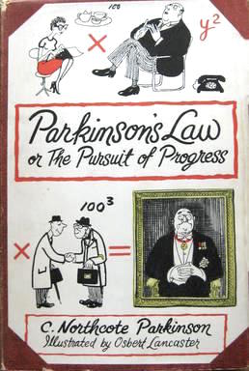
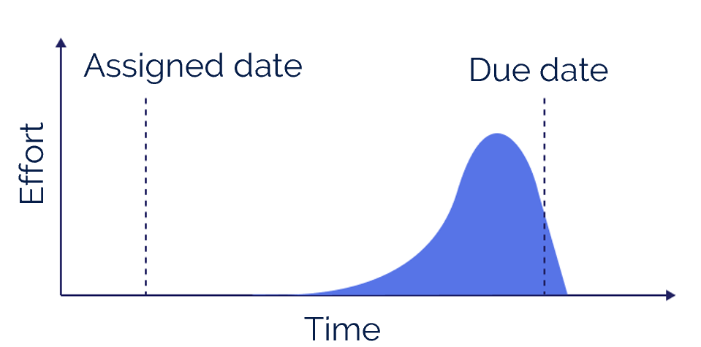
The impact of people on project performance
Projects very often suffer from dysfunctional human behaviours e.g.
Parkinson’s law "work expands so as to fill the time available for its completion.“
Student syndrome “a phenomenon where people delay doing things until right before the deadline”

Slide 8
More behaviours…
Difficulty in estimating durations (uncertainties)
Exaggerating the need for contingency (safety) on tasks
Latest start dates can encourage people to start tasks then – the whole network becomes a critical path
Sometimes, we ignore resource constraints until too late
Most people do not multi-task as well as they think
People very often tell senior managers what they want to hear
….All this can make Critical Path Analysis not work

Slide 9
Network analysis
Task A
10d
Task B
6d
Task C
10d
Task D
6d
Task E
10d
Task F
5d
Task L
10d
Task G
6d
Task H
4d
Task I
6d
Task J
5d
Task K
11d
All perfectly logical – planned duration of 42 days

Slide 10
The same project as a Gantt chart
A start and finish date can be calculated for every task
Starting with Task G on 02/01 and finishing with Task L on 17/02

Slide 11
Task deadline scheduling
The project manager may be attempting to impose an inflexible plan on a variable business environment
Actual start and finish dates of tasks will always change … and will need constant and continued updating
The completion date may also change constantly –probably backwards - leading to loss of control and stress?

Slide 12
Shouldn’t early and late finishes balance out?
Task A
10d
Task B
6d
Task C
10d
Task D
6d
Task E
10d
Task F
5d
Task L
10d
Task G
6d
Task H
4d
Task I
6d
Task J
5d
Task K
11d
Unfortunately - usually not! Late finishes are much more frequent – pushing back the completion date

Slide 13
Converging Tasks tied to schedule dates
As planned
Late finish - delay
Early finish – no benefit
Task A
5d
A
3d
Task A
5d
Task B
5d
Task D
10d
Task B
5d
Task D
10d
Task B
5d
Task D
10d
Task C
5d
Task C
5d
Task C
5d
Losses Accumulate – Gains Don’t

Slide 14
Critical Chain Management

Slide 15
Critical Chain Project Management
Based on the work of Eli Goldratt
Business novel – explains the idea as a story
Seeks to address the weaknesses of how time can be handled – procrastination, over-estimating, large contingencies, tasks expanding to fit time
Principle of managing the project as a whole chain – only as strong as it’s weakest link. Find the weakest link, fix it, find the next weakest link.
Referred to as a constraint or bottleneck

Slide 16
The CCPM approach – more flexible
No Due Dates / Deadlines assigned to tasks
Schedule is used only as a Dependency Chart
Work is progressed as a ‘Relay Race’
Task A
Task B
Task C
Task D
Task E
Task F
Task L
Task G
Task H
Task
I
Task J
Task K

Slide 17
Steps in Critical Chain Management
Identify: Identify the bottleneck of the system.
Exploit: Exploit this bottleneck, making its throughput efficient by changing processes, equipment maintenance procedures, training, policies, etc.
Subordinate: Subordinate the throughput of all parts of the project to this part
Elevate: Invest in this task/resource to increase its throughput - add equipment, manpower, etc.
Inertia: Start the process over on the line to determine the new bottleneck.

Slide 18
1. Identify the constraint (s)
Think project as a whole – manage it as a whole that is only as strong as the bottleneck.
Therefore….
Bottleneck

Slide 19
Contingencies (safety/extra) time not added to tasks
Traditional contingency planning
High levels of extra contingency are added to every task
CCPM – no task level contingency
Remove all task-level contingency – all task durations reduced
Task
A
Task B
Task
C
Task
A
Task B
Task
C
Task D
Task
E
Task F
Task
L
Task D
Task
E
Task F
Task
L
Task
G
Task H
Task I
Task
J
Task
K
Task
G
Task H
Task I
Task
J
Task
K

Slide 20
Tasks are completed as soon as possible
Traditional way of working
Parkinson’s Law – ‘Work expands to fill the time available’
Student syndrome – Extra time at the beginning is not used (built in procrastination)
Early finishes rarely happen!
CCPM
Task Estimates have no in-built contingency
Shorter task durations & much reduced timeline
Tasks complete as soon as possible
Without deadlines to fuel Parkinson and Student Syndrome behaviours, there is more chance of an early completion
Possible
early finish
Official deadline
Task L
10d
Task L
10d
Actual time saving
Missed time saving

Slide 21
CCPM Project-Level Contingency
Task A
Task B
Task C
Project commit date
Task D
Task
E
Task F
Task
L
Project Buffer
Task G
Task H
Task I
Task J
Task K
The Buffer protects the project – not individual tasks
It provides the project Commit Date

Slide 22
What if a task finishes late?
Task A
Task B
Task C
Buffer status
Project commit date
Task D
Task E
Task F
Task L
Project Buffer
Task G
Task H
Task
I
Task J
Task K
Critical Task over-runs are absorbed by the project buffer
The Project Commit Date is not affected
Buffer status shows the impact on contingency

Slide 23
What if some tasks finish late and some early?
Task A
Task B
Task C
Buffer status
Project commit date
Task D
Task E
Task F
Task L
Project Buffer
Task G
Task H
Task
I
Task J
Task K
If a Critical Task finishes early… the time saved is ‘added back’ into our contingency
Buffer Status always shows the latest position

Slide 24
1. Identify what is causing the bottleneck
What is slowing the project down?
Critical path
Resource constraints: availability, skills, etc.
Immovable dates
Psychological and/or cultural aspects – behaviours, practices, customs
Bottleneck

Slide 25
Critical Path – logical cause of bottleneck
This can be the main bottleneck and is a place to start….
Task A
Task B
Task C
Task D
Task
E
Task F
Task
L
Task G
Task H
Task I
Task J
Task K

Slide 26
Resources are another likely source of bottleneck
Tasks B and I require Resource A
Tasks C and F require Resource B
Both Resources A and B are assigned to two tasks at the same time
Task A
Task B
Task C
Task D
Task E
Task F
Task L
Task G
Task H
Task
I
Task J
Task K

Slide 27
Multi-tasking – the illusion of productivity?
Minor delay
Single tasking – 28 days?
Task A 9d
Task B 9d
Task C 9d
Multi-tasking – 30 days?
3d
3d
3d
3d
3d
3d
3d
3d
3d
Task A complete
Task B complete
Task C complete
Every project task is late. Quality might be poorer

Slide 28
Resource conflicts and multi-tasking
Quality may well be reduced
Work becomes fragmented
Multi-tasking takes longer and extra hours needed
Management control ebbs away
High potential for slippage
Diminishing returns due to staff morale / burnout
Last resort is often a scope cut
Which further degrades quality and acceptability
The overall chances of success are lower?

Slide 29
2. Exploit the bottleneck
Fix the bottleneck – do anything to get that constraint to work at maximum potential
Keep it going, remove anything that impedes progress
Could include:
Process improvement
Training
Maintaining the equipment
Etc.
Exploit

Slide 30
Resource smoothing or levelling
Resource constraint identified
Tasks B and I require Resource A
Tasks C and F require Resource B
Both A and B are assigned to two tasks at the same time
Resource Levelling
Levelling solves the problem
– but may increase the time scale
Task A
Task B
Task C
Task A
Task B
Task C
Task D
Task E
Task F
Task L
Task D
Task E
Task F
Task L
Task G
Task H
Task
I
Task J
Task K
Task G
Task H
Task
I
Task J
Task K

Slide 31
3. Subordinate
Anything else becomes less important
The focus is on project completion, not task completion, in critical chain project management – remember - buffer is added to the project, not task.
Make sure everything is ready for that task/resource/part of the project
Subordinate

Slide 32
4. Elevate
Invest in this task/resource
Do we need more equipment?
Do we need more people?
What can be done to speed this task/resource up?
Elevate

Slide 33
5. Inertia - Repeat
Identify: Identify the bottleneck of the system.
Exploit: Exploit this bottleneck, making its throughput efficient by changing processes, equipment maintenance procedures, training, policies, etc.
Subordinate: Subordinate the throughput of all parts of the project to this part
Elevate: Invest in this task/resource to increase its throughput - add equipment, manpower, etc.
Inertia: Start the process over on the line to determine the new bottleneck.

Slide 34
Communication

Slide 35
Communication with your team and stakeholders
Communication can have a range of functions, for…
Control
Motivation
Emotional Expression
Information
Source
Encoding
Channel
Decoding
Receiver
Feedback

Slide 36
Communication Networks
Chain
Wheel
All Channels

Slide 37
Barriers to Effective Communication
Filtering - the distortion or withholding of information to manage a person's reactions
Selective Perception - the tendency not to notice and more quickly forget stimuli that cause emotional discomfort and contradict our prior belief
Emotions – can impede ability to deliver or receive a message
Language barriers

Slide 38
Listening Skills
Hearing
Focusing on the message
Comprehending and interpreting
Analyzing and Evaluating
Responding
Remembering
Notes:
Listening is not my problem!
Listening and hearing are the same
Good readers are good listeners
Smarter people are better listeners
Listening improves with age
Learning not to listen
Thinking about what we are going to say rather than listening to a speaker
Talking when we should be listening
Hearing what we expect to hear rather than what is actually said
Not paying attention
( preoccupation, prejudice, self-centeredness, stero-type)
Listening skills are difficult to learn

Slide 39
Giving Feedback to your Project Team
Positive vs. Negative Feedback
Positive feedback is more readily and accurately perceived than negative feedback
Positive feedback fits what most people wish to hear and already believe about themselves
Negative feedback is most likely to be accepted when it comes from a credible source if it is objective in form
Subjective impressions carry weight only when they come from a person with high status and credibility

Slide 40
Developing Effective Feedback Skills
Focus on specific behaviours
Keep feedback impersonal
Keep feedback goal oriented
Make feedback well timed
Ensure understanding
Direct feedback toward behaviour that is controllable by the recipient

Slide 41
Communicating with Stakeholder Power/Interest Grid
Stakeholders
Key Player and Manage expectations
Highest priority for the project manager
Manage actively through active engagement
Keep satisfied
Moderate priority group
Need to keep this group sufficiently involved
High
Power
Stakeholder mapping
Monitor only
Lowest level for the project manager
Don’t overload them with communication
Keep informed
Moderate priority group
Objective is to sustain their interest and leverage when useful to the project
Low
Low
Interest
High

Slide 42
How do I find out who my stakeholders are? FINDING STAKEHOLDERS
People I can think of who will…
 | Benefit from the change /project | Be damaged as a result of the change /project
Are involved, but the change /project could happen without them | 1 | 2
The change /project could NOT happen without them | 3 | 4
Code | Action
1 | Ask these people up front to commit to support project/change. They will be a great invisible resource.
2 | No need to create enemies. Use issue-data-question-build to emotionally engage.
3 | Try to get strong sponsorship from these people. Enlist them as allies to help manage other stakeholders.
4 | Approach with caution – you will need your antennae up and to exercise caution not to permanently alienate them.
People I can think of who…

Slide 43
How do I get them (even the awkward ones) to engage? – ENGAGING COMMITMENT
People who seem to…
 | NOT agree with the goals of your project /change | Agree with the goals of your project /change
Understand what you are trying to achieve | a | b
NOT understand what you are trying to achieve | c | d
Code | Action
a | Listen sincerely to their concerns and try to build them into your risks. Don’t try to ‘sell’ to them.
b | Don’t spend too much time on this group. Just don’t upset them.
c | Build trust. Get them to listen to the vision/approach (probably through a third party). Listen to their concerns.
d | Use an implications discussion to help them to recognise the impact of the change and become engaged.
People who seem to…

Slide 44
How do I find out what they will do to get in my way? – GUESSING MOTIVATIONS AND PREDICTING BEHAVIOUR
People I think might want the change/project to…
 | Succeed | Fail
Success | A | D
Failure | B | C
Code | Action
A | Nothing special. Delegate day-to-day management. Inform of decisions in advance – just don’t upset them
B | Listen to their criticism and accept offers of help.
C | Find out why they want failure. Remedy. Re-involve and inform of small and big wins.
D | Remove from the main action. Find out why they want failure. Remedy. Re-involve and inform of wins.
People who I think are betting on a change/project…

Slide 45
Who are the real show stoppers and how do I prevent them from stopping the show? – HIGHLIGHTING RISKS
People whose
 | Actions affect your success | Success you affect through your delivery
Showing real support | i | ii
NOT showing real support | iv | iii
Code | Action
i | Gain continuing participation. Watch for any signs of declining support and act immediately.
ii | Don’t overplay your hand and become coercive. Don’t upset them. Show them real gratitude for their help.
iii | Use an implications discussion to highlight the reasons they need to be more engaged in the project/change.
iv | Organise a straight talking implications session as soon as possible.
People who are…

Slide 46
Any questions
?
?
?
?
?
?
?

